Slide 1
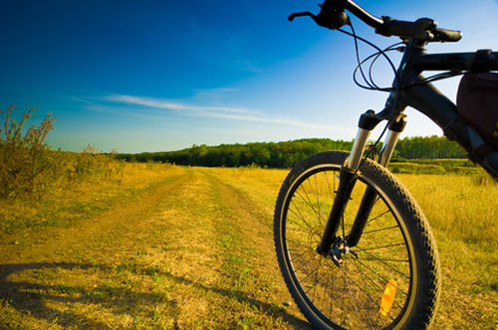
Hobbies
Boykov 10a

Slide 2
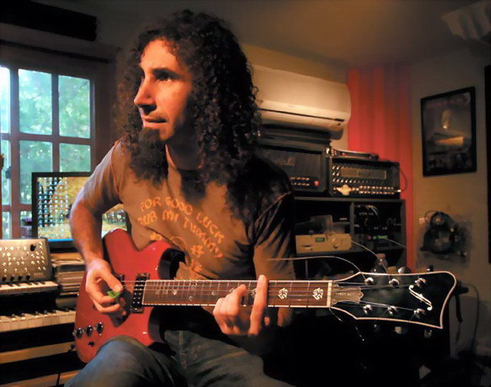
Playing musical instruments
The guitar is the most popular musical instrument
people around the world want to learn to play guitar

Slide 3
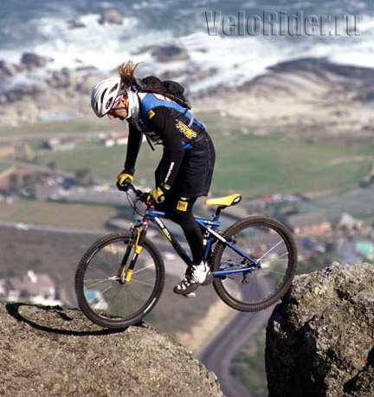
Trial
Representative of extreme sports is a trial
trial associated with overcoming specially built or natural obstacles on the bike, motorcycle, car

Slide 4
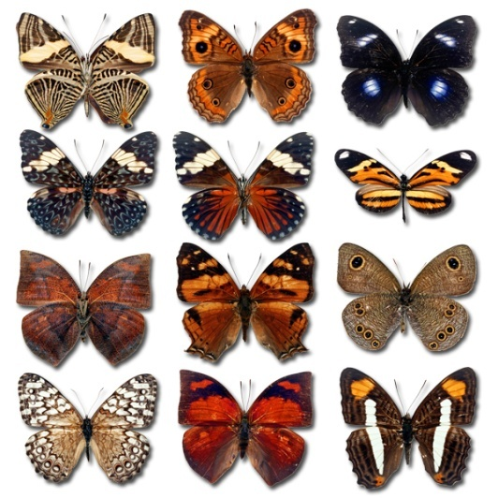
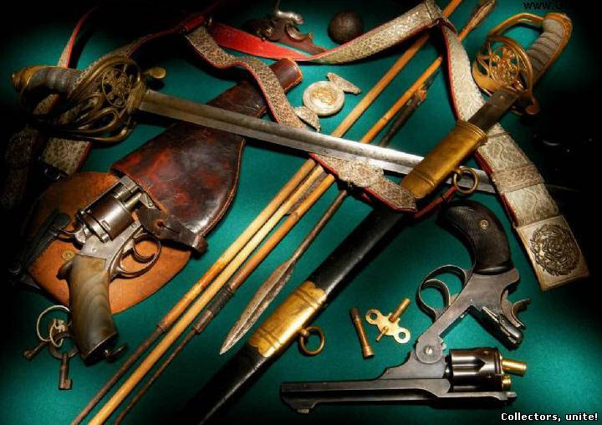
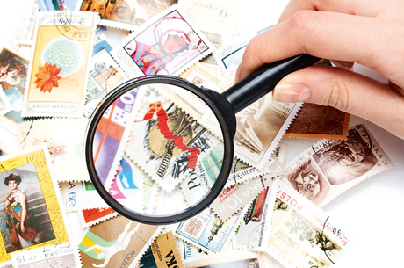
Collecting
A lot of people collect various items: coins, stamps, cars, posters, antiques
Usually such people have a lot of very rare things that are very expensive

Slide 5
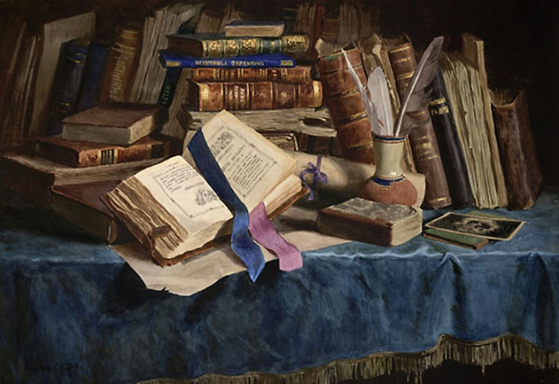
Reading books
read the book very interesting and useful. Books increases vocabulary person, enrich his inner world, make smarter and improve memory

Slide 6
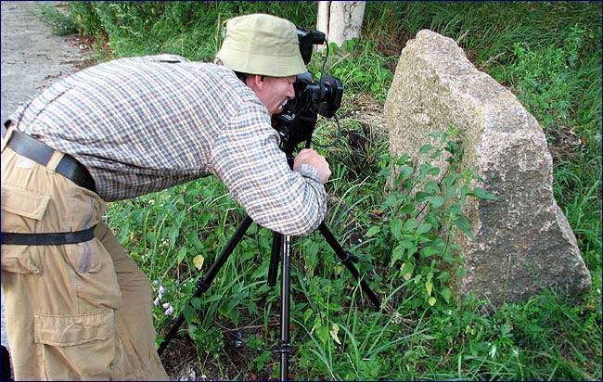
Photography
Man with a camera sees the world differently, he notes that, by what others can pass indifferently. Photographer to old age retains the ability to worry and wonder, to discover new faces and colors of life as a child

Slide 7
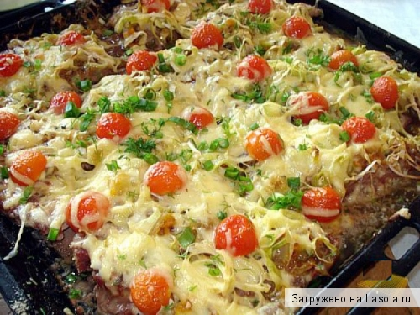
Cooking
Cooking - a great and rewarding hobby that will allow you to feel like a creator. Strongly encouraged improvisation and creative experiments. Hobby for people of different professions and different ages

Slide 8
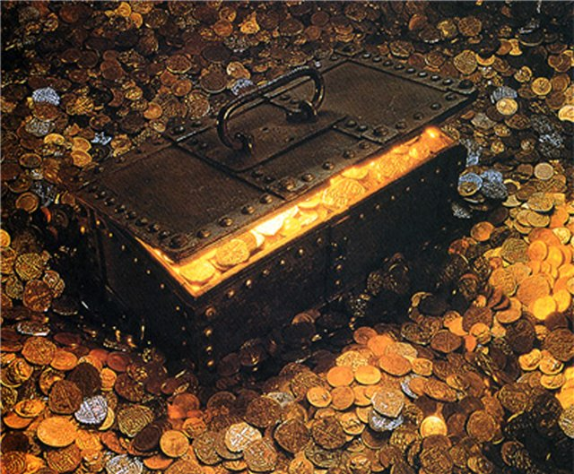
Treasure hunt
Treasure - buried in the ground or otherwise hidden money or valuable items, the owner of which is unknown and can not be found or lost on them right.

Slide 9
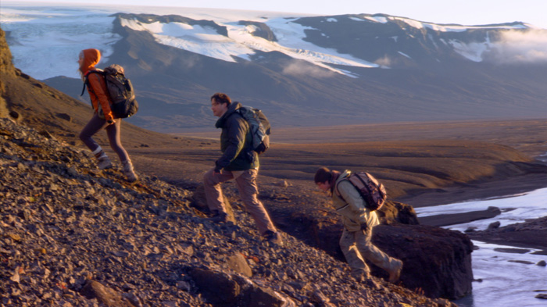
Traveling
People travel from the very beginning of their civilization. Travelling and visiting other places are the part of our consciousness. That is why tourism and travelling are so popular.

Slide 10
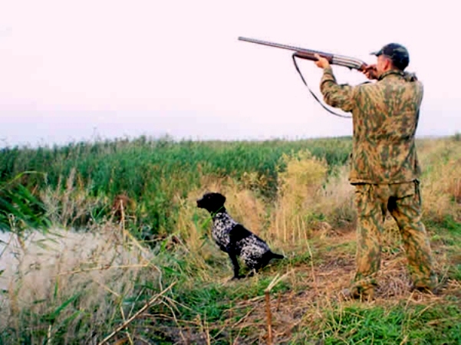
Hunting
Passion for hunting lies in men since ancient times. That they had to bring in mammoth cave and provide food to his woman and children. Hunting is no longer necessary and has become a pastime, gambling craze.

Slide 11
Спасибо за внимание

